Slide 1
 | Familles Homogènes (Même temps pour tous les famille sur une ressource donnée) | Familles Hétérogènes (Temps différent par famille)
Machines Identiques (Même ressource = même profil) | Cas 1 : Identical M1=[1,1,1] & M2=[1,1,1] | Cas 3 : Identical + Family Dependent M1=[1,2,3] & M2=[1,2,3]
Machines Hétérogènes (Ressource A ≠ Ressource B) | Cas 2 : Heterogeneous + Resource Dependent M1=[1,1,1] & M2=[4,4,4] | Cas 4 : Heterogeneous + Family Dependent M1=[1,2,3] & M2=[4,5,6]
I
I
IF
IF
HR
HR
HF
HF
Processing times
Setup times
Identical (I)
Identical + Family Dependent
Heterogeneous + Resource Dependent
Heterogeneous + Family Dependent
0 | No setup
ST≤ PT | Identical
 | Identical + Family Dependent
 | Heterogeneous + Resource Dependent
 | Heterogeneous + Family Dependent
ST>PT | Identical
 | Identical + Family Dependent
 | Heterogeneous + Resource Dependent
 | Heterogeneous + Family Dependent
I
0
IF
I
HR
IF
HF
HR
HF
I
IF
HR
HF
Cell #1
Cell #2
Cell #3
K13
D
D
D
I
D
D

Slide 2
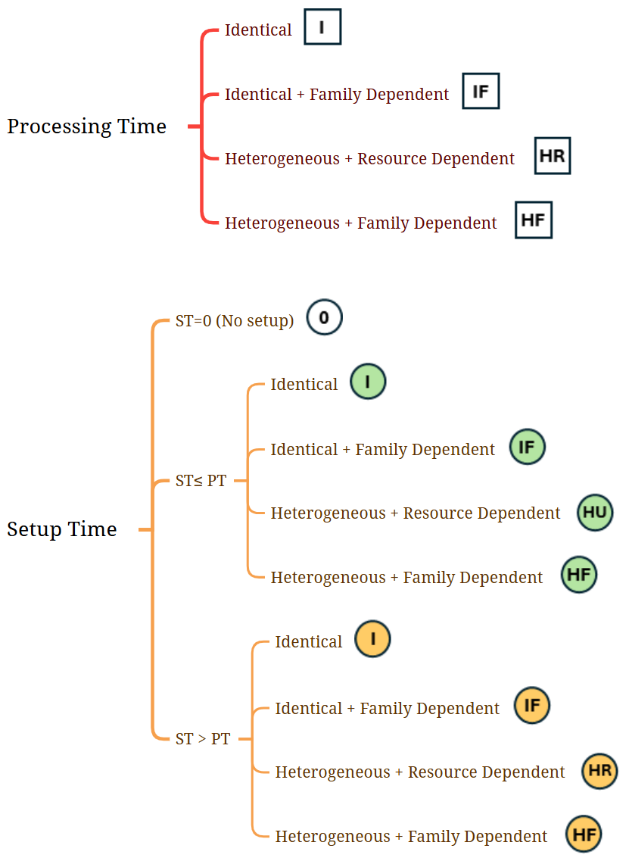
0
K13: "Factory configuration F_5F3C7M_232_4 with 3 cells.", "name": "F_5F3C7M_232_4",
resID": 1,"cellID": 1,"processVector": [4,3,3,2, 1 ],"setupVector": [2,1,2,2,1]
resID": 2,"cellID": 1,"processVector": [4,3,3,2,1],"setupVector": [2,1,2,2,1]
resID": 3,"cellID": 2,"processVector": [2,2,2,2,2],"setupVector": [0,2,2,2,1]
resID": 4,"cellID": 2,"processVector": [3,3,3,3,3],"setupVector": [2,2,2,2,2]
resID": 5,"cellID": 2,"processVector": [1,2,1,1,1],"setupVector": [2,2,2,2,2]
resID": 6,"cellID": 3,"processVector": [2,1,1,2,2],"setupVector": [1,0,2,1,1]
resID": 7,"cellID": 3,"processVector": [1,1,2,3,2],"setupVector": [1,2,0,1,1]
I
IF
HF
IF
HR
HF
HF
I
HF
IF
HR
HF
HF
HF
I
IF
HR
HF

